Slide 1

Filtering in Pandas 2

Slide 2
Filtering Dataframes
Group by
Compute aggregate statistics of groups in the data
Compute group sums or means
Perform some group specific transformations on the data
Fill NaNs of groups with mean of group
Filter the data based on some group-wise operations
Discard data that belongs to groups with only a few data points.

Slide 3
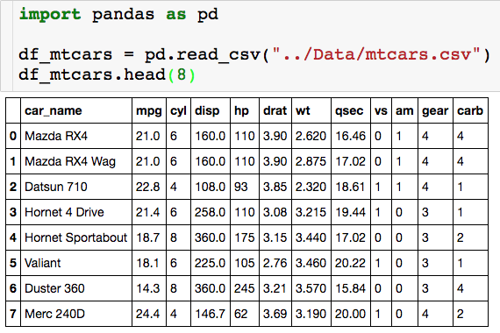
Looking at mtcars Again

Slide 4
Looking at mtcars Again
What is the avg mpg for each cylinder type?

Slide 5
Groupby in Pandas - Aggregating

Slide 6

Basic Group By
Create groups based on unique entries in cyl column

Slide 7
Basic Group By
Create groups based on unique entries in cyl column
For each group compute the mean mpg

Slide 8
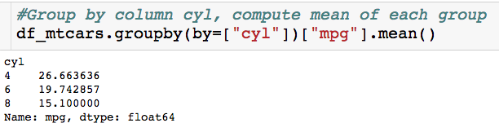
Basic Group By
Returns a series where the indices are the groups

Slide 9
Basic Group By
Returns a series where the indices are the groups
Remaining Questions:
Can I group by more than one column?
Can I compute more than one aggregate statistic for each group?
For each group can I customize how I summarize each column that I select?

Slide 10
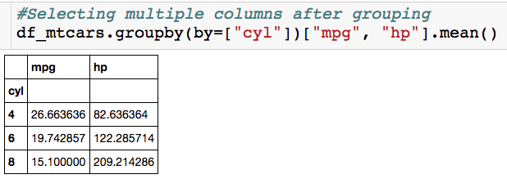
Selecting Multiple Columns
Specify the columns you want
We get avg mpg and hp for each of the three cylinder groups.
Since we are selecting two columns we get back a dataframe

Slide 11
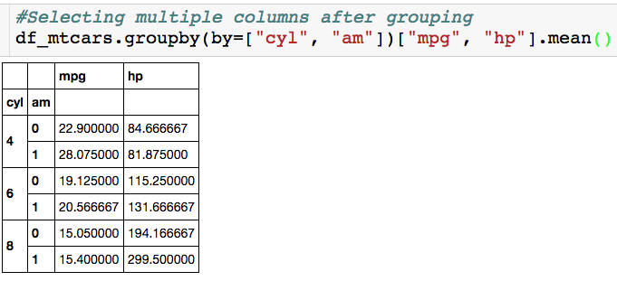
Grouping By Multiple Columns
Specify columns you want to group by
We have a group for every combination of cyl and am.
We get avg mpg and hp for each of the six groups.
We get a multi-indexed dataframe (two row names).

Slide 12
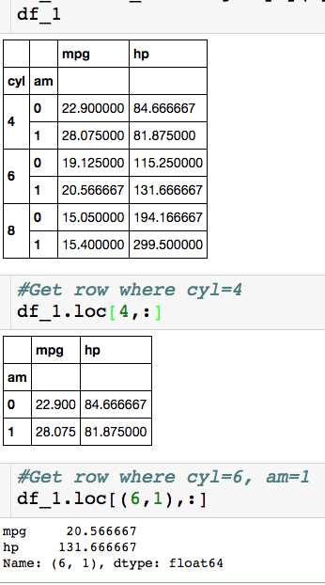
Slicing Multi-indexed DataFrame
Options 1:

Slide 13
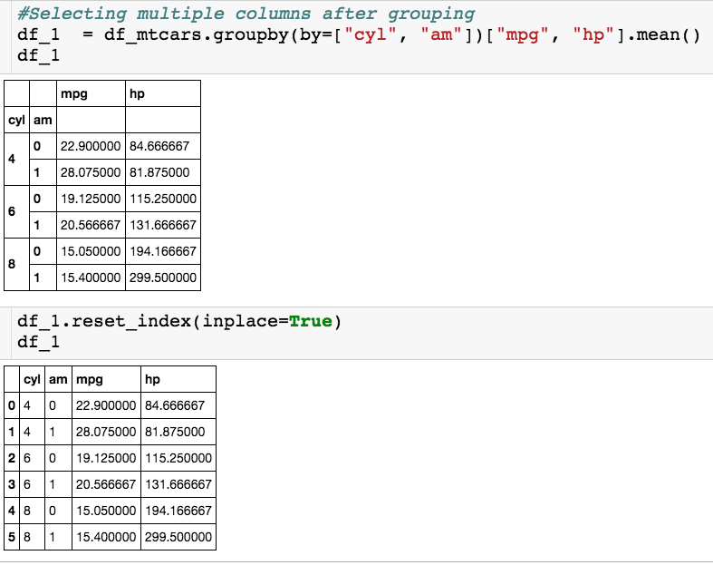
Just Reset Index…
Options 2:

Slide 14
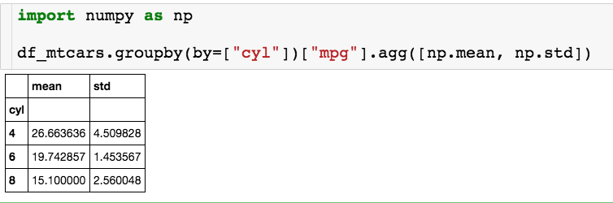
Apply Multiple Functions
List of functions I want to apply to groups
For each group of cylinders we get the mean and stdev mpg.

Slide 15
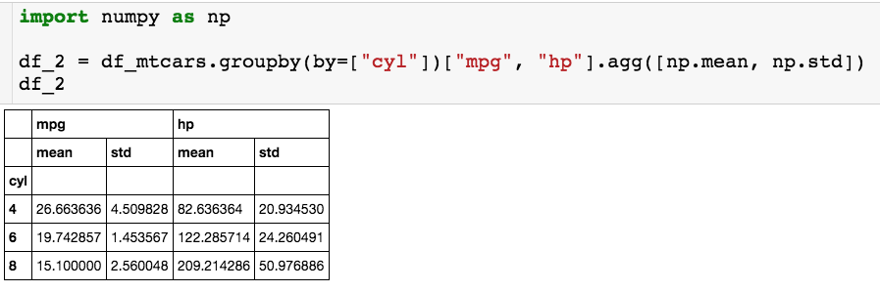
Apply Multiple Functions to Multiple Columns
For each group of cylinders we get the mean and stdev of mpg and hp.
Get dataframe with multi-indexed column names

Slide 16
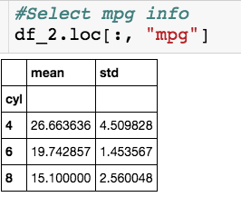
Apply Multiple Functions to Multiple Columns
Get dataframe back

Slide 17
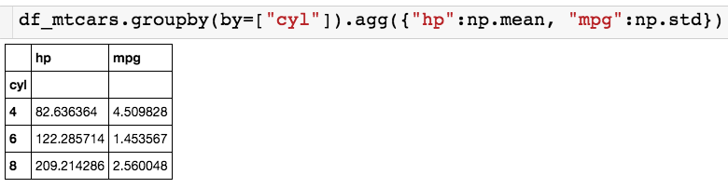
Apply Multiple Functions to Multiple Columns
Dictionary
For hp column compute mean of groups and for mpg column compute standard deviation

Slide 18
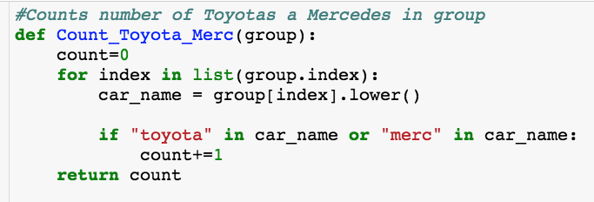
Apply Custom Function to Column

Slide 19
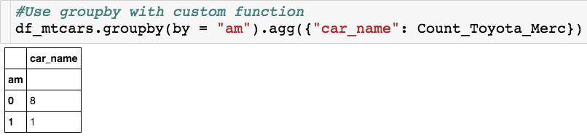
Apply Custom Function to Column
Assume group is passed as series.

Slide 20
Groupby in Pandas - Transforming

Slide 21
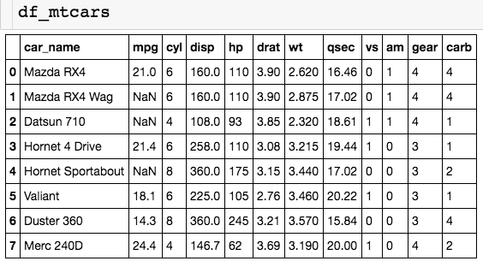
Looking at Modified mtcars
Transforms preserve the shape of the original data frames.
Lets us transform the data for each group.

Slide 22
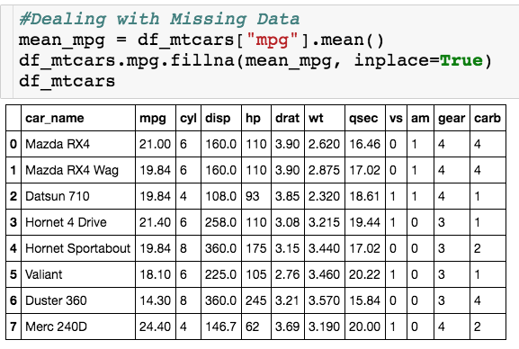
Using fillna()
All missing values replaced by same mean!

Slide 23
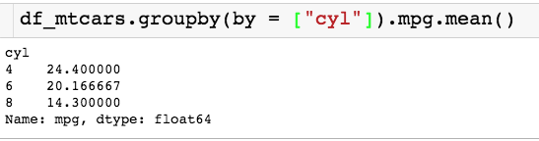
Using a Transform
I’d like to replace each NaN with its cyl group mean for example.

Slide 24
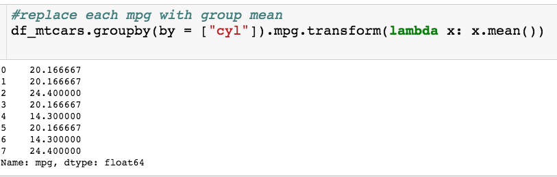
Using a Transform
x is group as series
Function to be applied to group

Slide 25
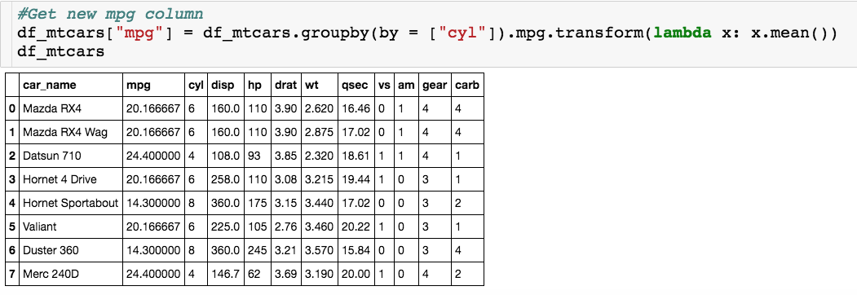
Using a Transform

Slide 26
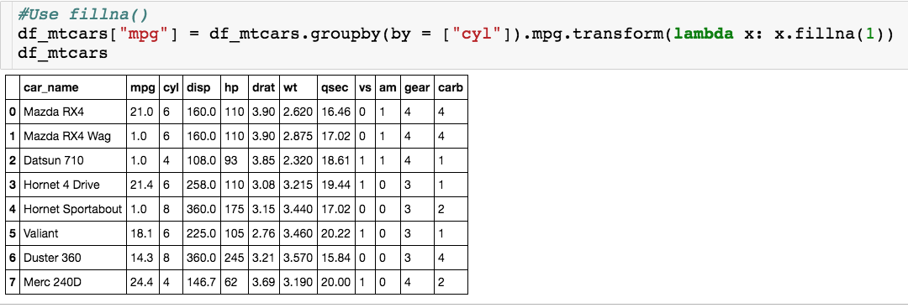
Using a Transform
Filled each NaN with 1

Slide 27
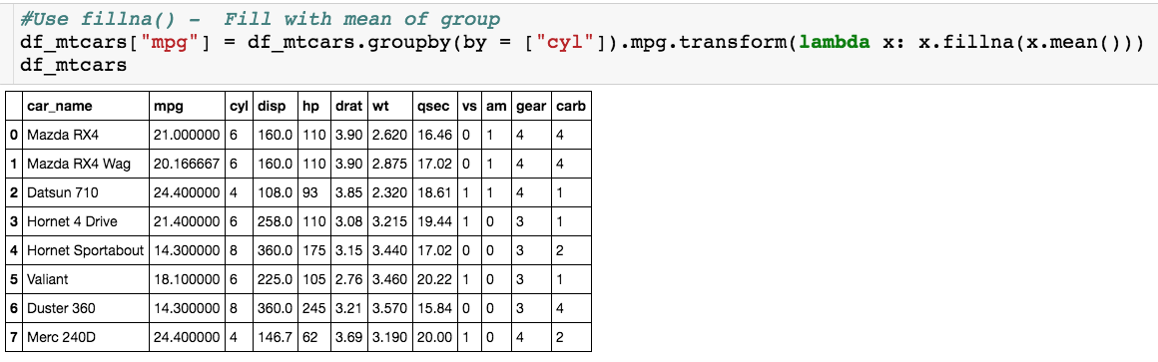
Using a Transform

Slide 28
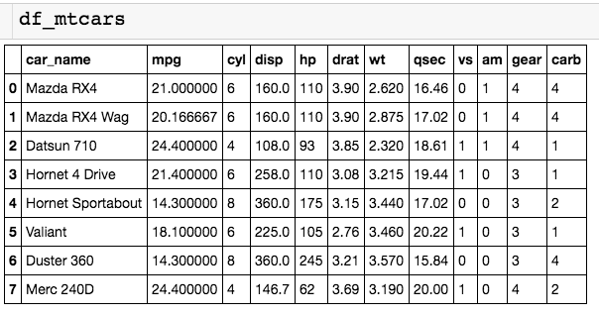
Normalizing for Units
Hard to tell quickly what is small and large values for these columns

Slide 29
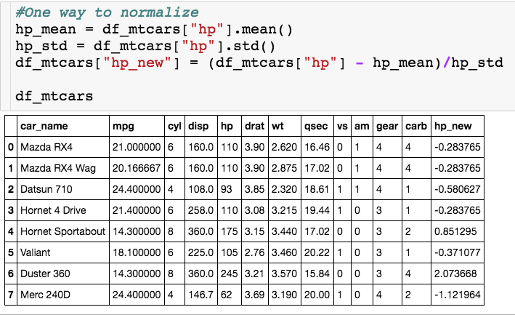
Normalizing for Units
Standard deviations from the mean

Slide 30
Normalizing for Units
Standard deviations from the mean
What if I want to normalize based on groups?

Slide 31
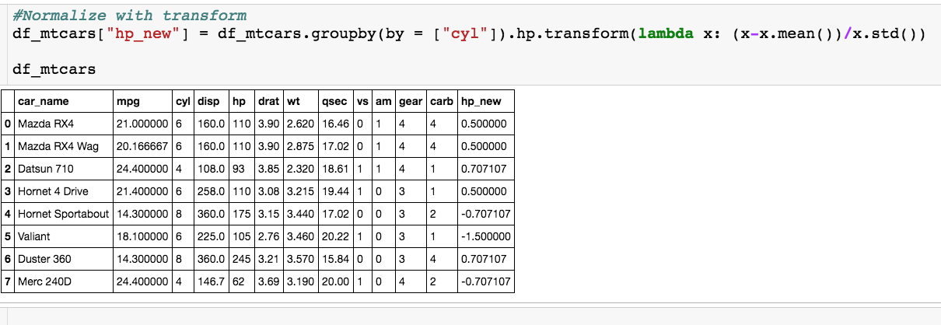
Normalizing for Units
Normalize based on mean and stdev for each group.

Slide 32
Groupby in Pandas - Filtering

Slide 33
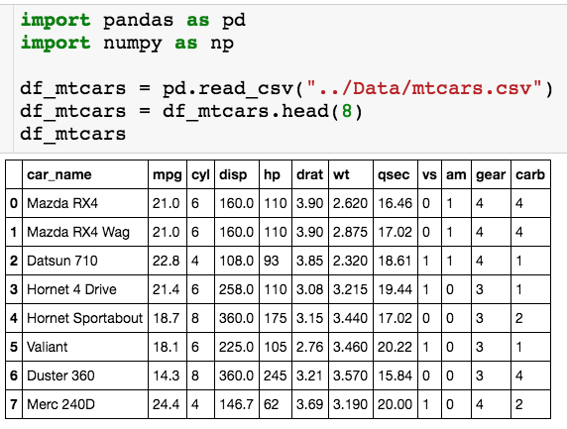
Looking at Modified mtcars
What if I only want to look at certain groups…
Groups that have “enough” data
Groups whose mean is above a certain value.

Slide 34
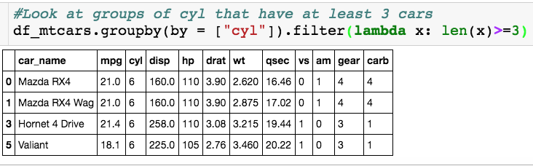
Filtering
Function you pass to filter must return a boolean: True for keeping the group and False for getting rid of it.

Slide 35
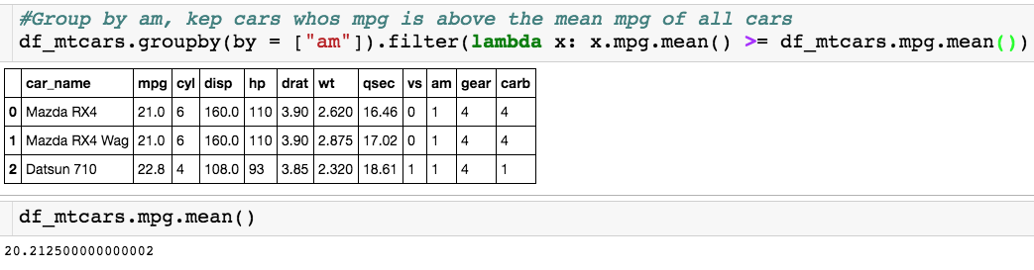
Filtering

Slide 36
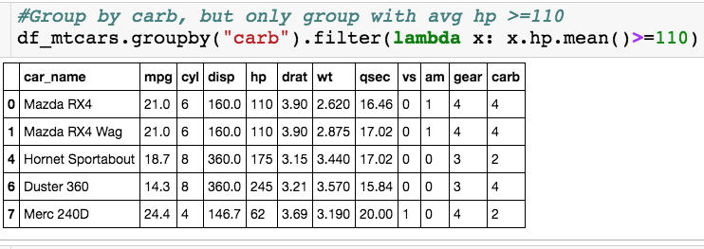
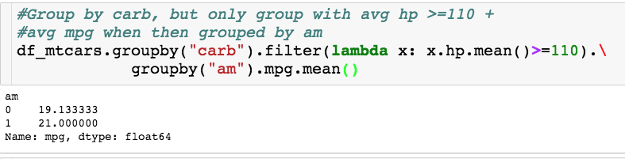
Filtering + Aggregate

